Slide 1

Rocking Work
Being Yourself in a Diverse Team
Ruth Mills
Lead Developer
Connect Group
Twitter: @ruthmills
Web: www.ruthmills.me.uk

Slide 2
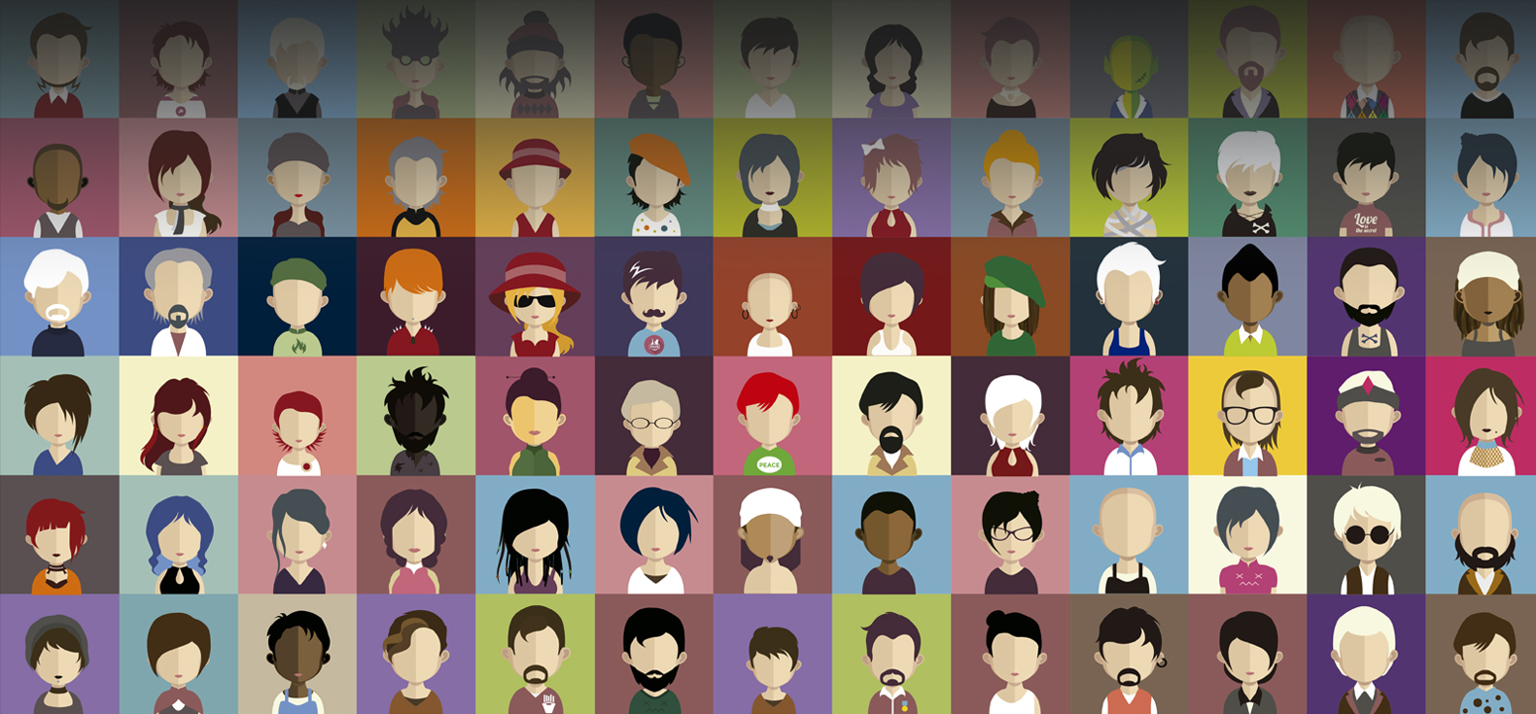
Diversity – what is it?

Slide 3
Diversity of People
Race
Religion
Nationality
Gender
LGBT (Lesbian, Gay, Bisexual, Transgender)
Disability
Autistic Spectrum
Mental Health
And more!

Slide 4
Diversity of Thought:
Different ways of thinking and working
A strong team needs many different kinds of people
Agile teams are multi-disciplinary – e.g. Scrum Master, Product Owner, Business Analyst, Developers, QA Testers, etc
Different personality types – e.g. Myers-Briggs, Harry Potter Sorting Hat, etc
Having a wide mix of different personalities makes for a more dynamic team with a more creative approach to problem solving

Slide 5
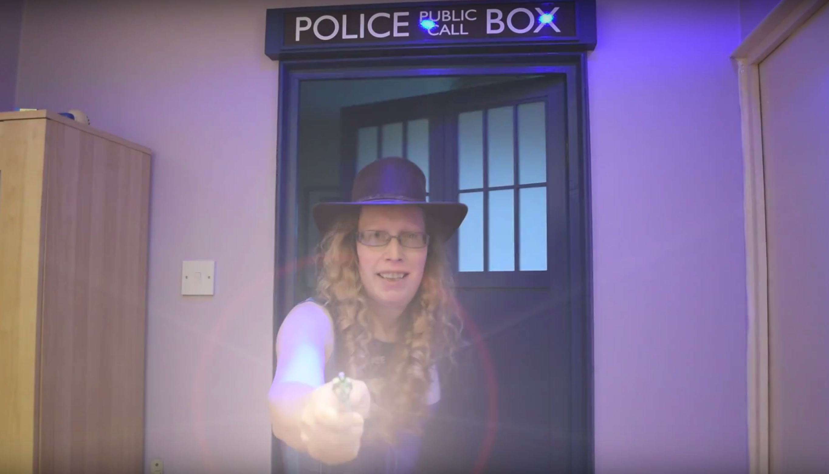
Being myself at work
My Regenderation

Slide 6
Being myself at work – my own story
Changed my name and title on 13th August 2012
Went full time in previous contract on 15th April 2013
Interviewed at Connect on 16th September 2013
Saw my GP on 23rd September 2013
Started at Connect as a contractor on 30th Sept 2013
First appointment at gender clinic on 23rd May 2014
Went permanent for Connect on 1st August 2014
Gender Reassignment Surgery on 4th November 2016

Slide 7
Being Yourself at Work
Don't need to waste energy pretending to be someone you're not
Being free to be yourself makes you so much happier and more confident
Better inter-personal skills and teamwork
You don't have to worry about saying something about yourself, e.g. if you are LGBT and in a same-sex relationship – or worry about “passing” if you're transgender

Slide 8
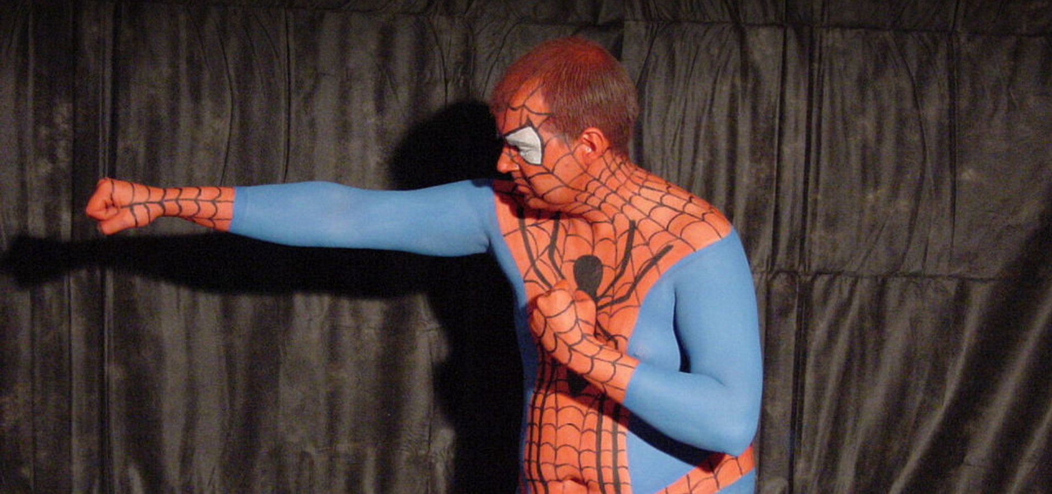
With great power comes great responsibility
If you are able to be yourself at work, you must respect other people for being themselves too

Slide 9
Why Diversity is great for business
Much happier working environment
Better communication on the team
Easier to attract and retain top talent
Can help with getting new clients
Better creativity and problem solving

Slide 10
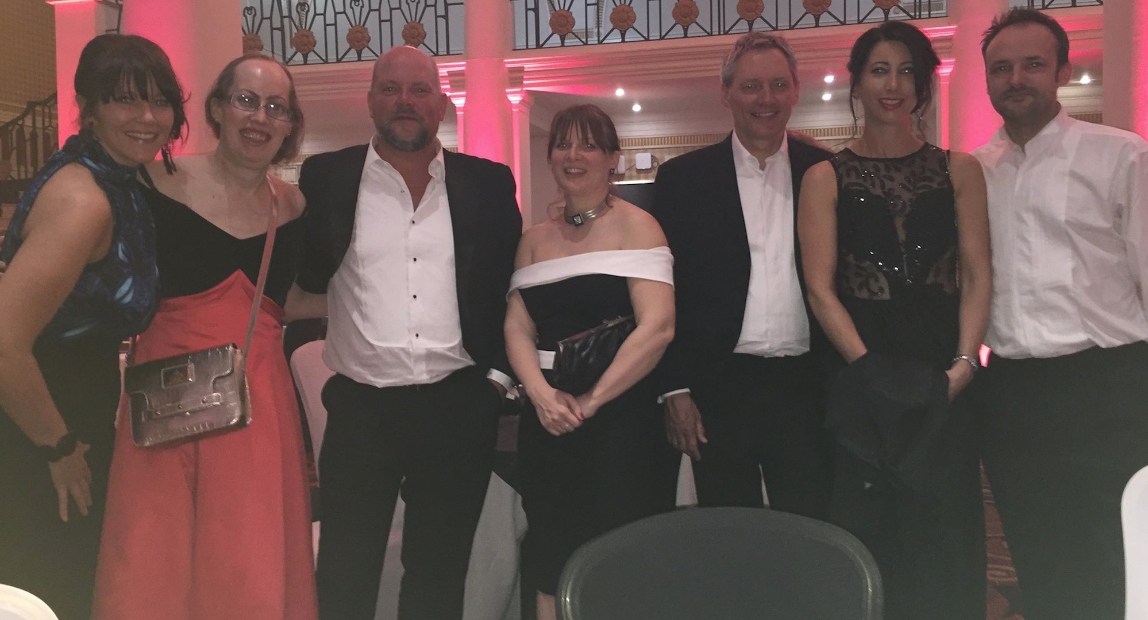
Connect Group at the
Excellence in Diversity Awards

Slide 11
Giving Something Back:
Diversity Role Models
Diversity Role Models are a charity set up to help stop anti-LGBT bullying in schools
DRM organise workshops in schools where adult role models tell their stories, e.g. about how they were bullied in school for being LGBT, and how they are living their lives as their authentic selves now
DRM are always looking for new volunteers – you can be lesbian, gay, bisexual and/or transgender, or a straight ally

Slide 12
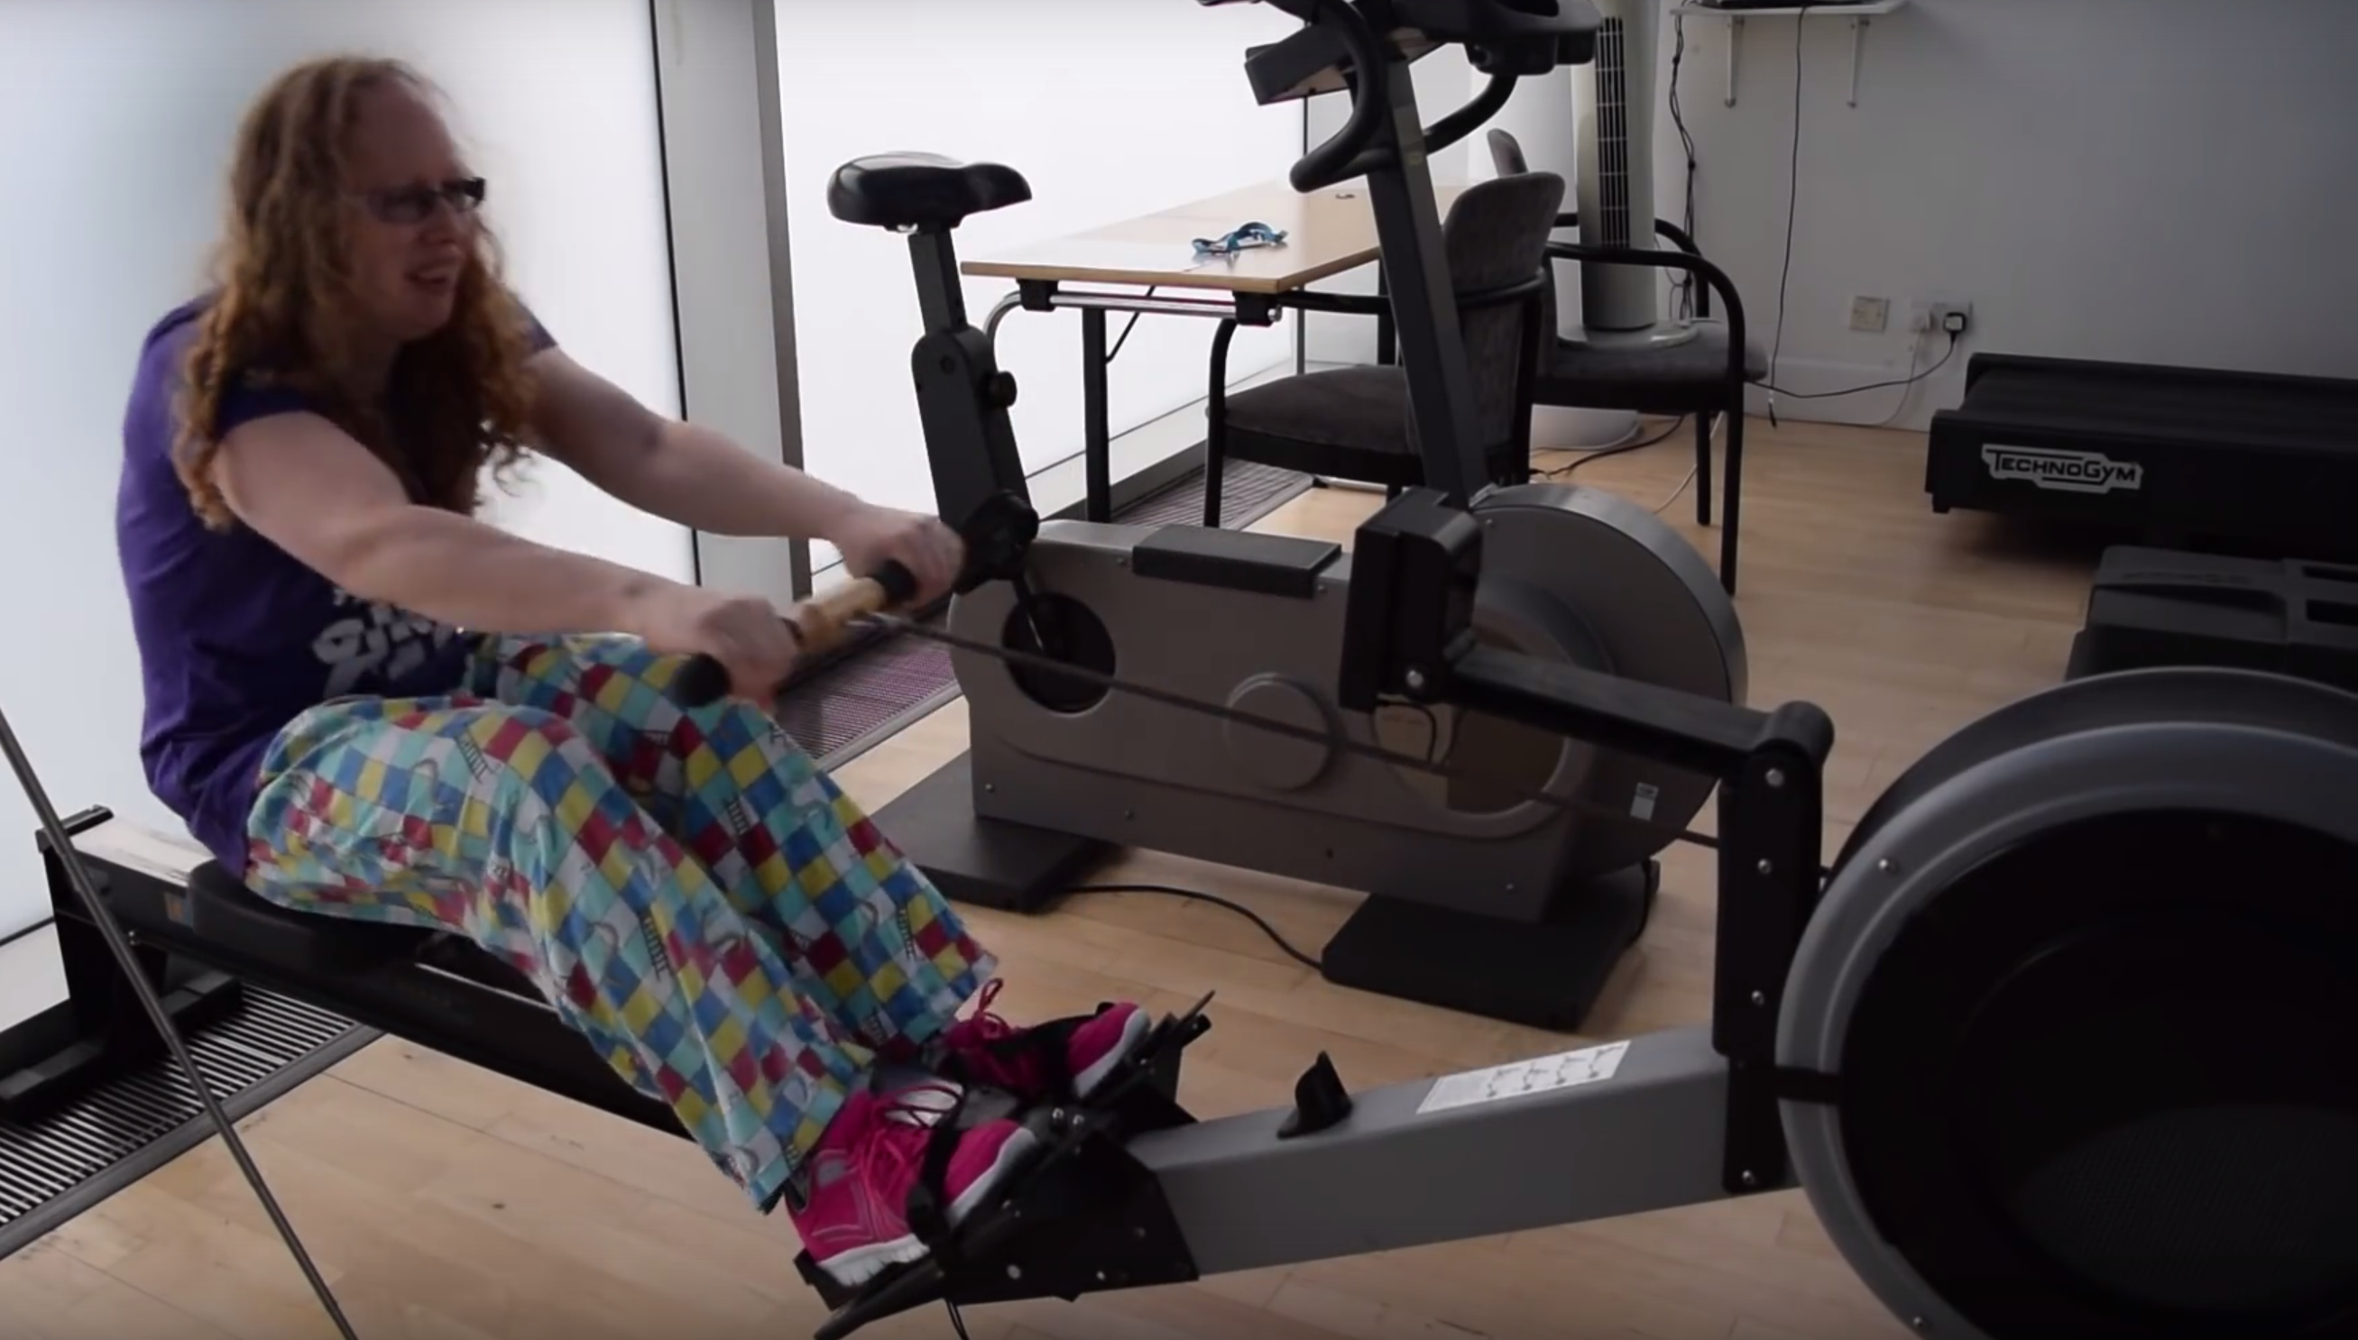
Diversity Role Models
Rowing Challenge
www.justgiving.com/fundraising/Ruth-Mills-DRM

Slide 13
Further Resources
Diversity Role Models – Twitter: @DiversityRM www.diversityrolemodels.org
Trans Workers UK – Twitter: @TransWorkersUK
Stonewall -
www.stonewall.org.uk/get-involved/workplace
Excellence in Diversity Awards –
Twitter: @EiDAWARDS www.excellenceindiversity.co.uk

